Slide 1



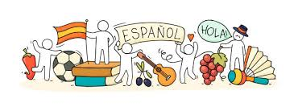
Y9 KNOWLEDGE ORGANISER: Topic 2 Part 1 Mi insti y la educación en España
New concepts and skills
The verb estudiar
School day using times
Facilities in your school
Developed opinions
School rules
Key information:
Useful phrases
Creo que I think that
Diría que I would say that
Según yo According to me
Hay/ no hay There is/ there isn’t
Primero Firstly
Segundo Secondly
Key verb
Assessment
Mid-Year Assessment
→Listening, Reading, Dictation & Writing
Key Questions:
1. ¿Qué estudias en tu insti?
2. ¿Qué hay en tu instituto?
Pronoun | Estudiar- to study (present)
yo (I) | Estudio
tu (you) | Estudias
él/ella (he/she) | Estudia
nosotros (we) | Estudiamos
vosotros (you pl) | Estudias
ellos/ellas (they) | Estudian
CEIAG Links
EMPLOYABILITY SKILLS:
- Raising aspirations: Aiming high for my future success.
- Considering future options: Thinking about post-16 options
- Self reflection: Thinking about my skills and my choices.
Links to prior learning
School subjects
Use of the verb ser
Regular and irregular present tense verb conjugations
Use of porque/ ya que to give justified opinions
Telling the time.

Slide 2
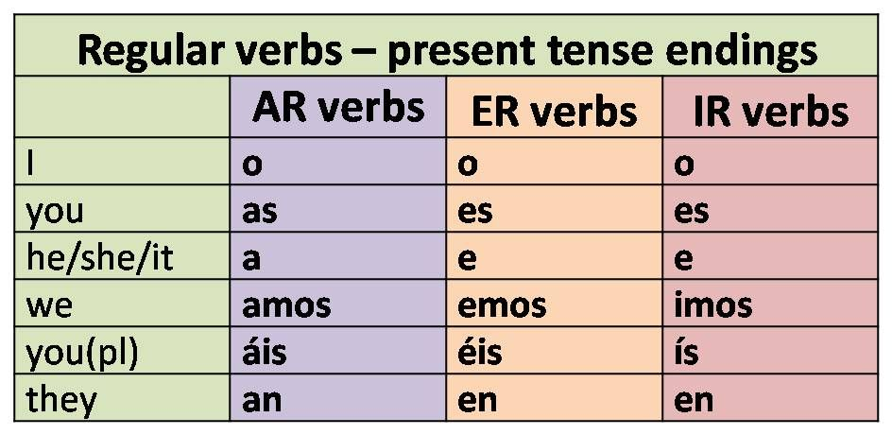

Y9 KNOWLEDGE ORGANISER: Topic 2 Part 2 Mi insti y la educación en España
New concepts and skills
School rules and school environment
Extra-curricular activities using present tense verbs and opinions
Future plans and ambitions using the near future tense
Key information:
Useful phrases:
Se debe you must
No se debe you musn’t
Se puede you can
No se puede you can’t
Estudié I studied
Me gustaría I would like
Quisiera I would like
Present tense verb endings:
Assessment
Key piece with individual written teacher feedback on mini paragraph Mi insti.
End Of Year Assessment
→Listening, Reading, Dictation & Writing
Key Questions:
3. ¿Qué se debe hacer?
4. ¿Haces actividades después de las clases?
5. ¿Qué hiciste ayer en tu instituto?
6. ¿Qué planes tienes para el futuro?
Links to prior learning
Regular and irregular present tense verb conjugations
Use of porque/ ya que to give justified opinions
Telling the time
Use of the past tense
Near future tense
CEIAG Link
- EMPLOYABILITY SKILLS:
- Raising aspirations: Aiming high for my future success.
- Considering future options: Thinking about post-16 options
- Self reflection: Thinking about my skills and my choices.

