Slide 1
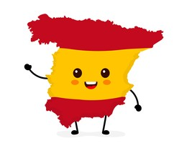




Y9 Topic 1 KNOWLEDGE ORGANISER: Yo y mi mundo
New verbs
Acabar de…- just
Melómano/a- music lover
Descargar- to download
Subir- to upload
Poner- to put
New opinion phrases
Preferir… a - I prefer… to
Creo que / Diría que / Según yo – I think that / I would say that / According to me
Key verb
New concepts and skills
-Describing famous people including cconfidently using the superlatives ‘lo mejor’ and ‘lo peor’.
-Giving information about TV programs.
-Making comparisons with ‘preferir… a…’ when discussing musical tastes.
-Forming negative phrases.
Assessment
End of Topic Assessment
→Listening, Reading & Translation
→Writing
Key questions
1. ¿Quién es tu famoso favorito?
2. ¿Qué instrumento quieres tocar?
3. ¿Qué ponen en la televisión?
4. ¿Cuáles son tus aplicaciones favoritas?
Pronoun | Preferir- to prefer (present)
yo (I) | Prefiero
tu (you) | Prefieres
él/ella (he/she) | Prefiere
nosotros (we) | Preferimos
vosotros (you pl) | Prefereis
ellos/ellas (they) | Prefieren
Links to prior learning
- Use of the verbs tener, ser and estar
- Physical descriptions and personality traits
- Regular and irregular present tense verb conjugations
- Limited preterit tense verb conjugations
- Use of porque/ ya que to give justified opinions
- Telling the time
CEIAG Links
Events Manager
SKILLS:
Organisation & Communication: Discussing client requirements.
Negotiation: Agreeing budgets & timescales.
Research: e.g. venues/materials, contacts & suppliers.
Advertising: Publicising the event & designs.

