Slide 1

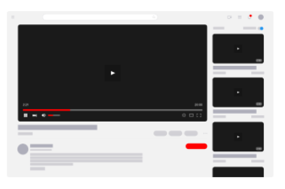


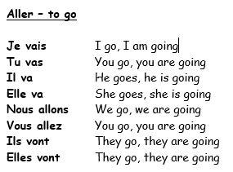

Y9 Topic 2 KNOWLEDGE ORGANISER: Les technologies
New concepts and skills
To learn new technology vocabulary and verbs e.g. to download
To discuss the pros and cons of technology using ‘on peut’, ‘on veut’ and ‘on doit’
To use verbs followed by prepositions and infinitives e.g. I decided to…
To develop range of negatives
To listen and read passages about technology and influencers in 3 tenses, identifying relevant information
To create an extended written passage about a YouTuber
New vocabulary
On peut - You can
On veut – You want
On doit – You must
e.g. on peut télécharger –
You can download
Negatives
ne …pas not
ne…jamais never
ne…rien nothing
ne…plus no longer
ne…que only
ne…personne no one
Immediate Future Tense
Assessment
Mid-year assessment →Listening, Reading & Dictation
Key piece Imagine que ton frère ta soeur ou ton ami est Youtubeur ou influenceur.
End of Topic Assessment →Listening, Reading & Grammar
Key questions
Tu es technophile ou technophobe?
Tu aimes les influenceurs?
En ligne ou en réalité?
C’est le passé, le présent ou le futur?
CEIAG Link
Technology-Specific Vocabulary & Life Online
Industry Link: Digital (e.g., social media managers, digital strategists, content creation, software developers, cyber security)
Skill: Digital Literacy – Understanding and using digital tools effectively is crucial for modern workplaces. You’ll also need accuracy and attention to detail.
Future Skill: Cultural Awareness in Digital Media – Knowing global trends and Francophone culture can make individuals effective communicators in the digital space.
Links to prior learning
Grammar - infinitives, negatives (ne …pas), free time activities, the present, perfect and immediate future tenses
E,g.
Je vais créer du contenu
Je vais devenir Youtubeur

