Slide 1


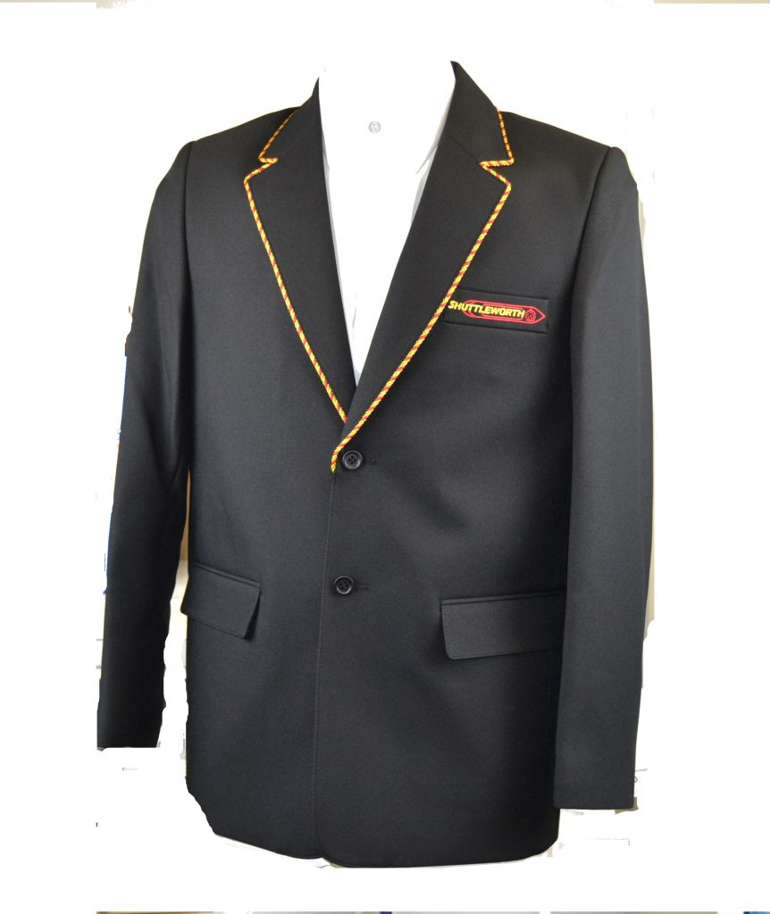

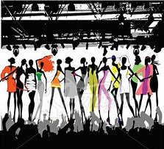
Y9 Topic 1 KNOWLEDGE ORGANISER: Les vêtements, la mode et le passé composé
New concepts and skills
Learn clothing vocabulary, including school uniform
Learn clothing vocabulary, including school uniform
How to form the passé composé
Describe a visit to a festival or celebration
Answering questions in 3 tenses
New vocabulary - Le passé composé
Past tense regular -ER verbs
développer ma confiance en moi
to develop my self-confidence
travailler pour une école verte
to work for a green school
vivre heureux ensemble
to live happy together
Assessment
Grammar Assessment End of Topic Assessment →Listening, Reading & Translation Key questions Qu’est-ce que tu portes normalement? Qu’est-ce que tu portes au collège? Qu’est-ce que tu porteras? TOP SET ONLY Et le weekend dernier?
Avoir Choose WHO | Past participle É
J’ai | porté | I wore
Tu as | porté | You wore
Il / Elle / On a | porté | He / She / We wore
Nous avons | porté | We wore
Vous avez | porté | You guys wore
Ils / Elles ont | porté | They wore
CEIAG Links
Events Manager
SKILLS:
Organisation & Communication: Discussing client requirements.
Negotiation: Agreeing budgets & timescales.
Research: e.g. venues/materials, contacts & suppliers.
Advertising: Publicising the event & designs.
Links to prior learning
Present tense
Colours
Adjectival agreement
Time markers
Consecutive verb rule
e.g. je voudrais porter

