Slide 1
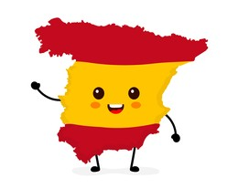
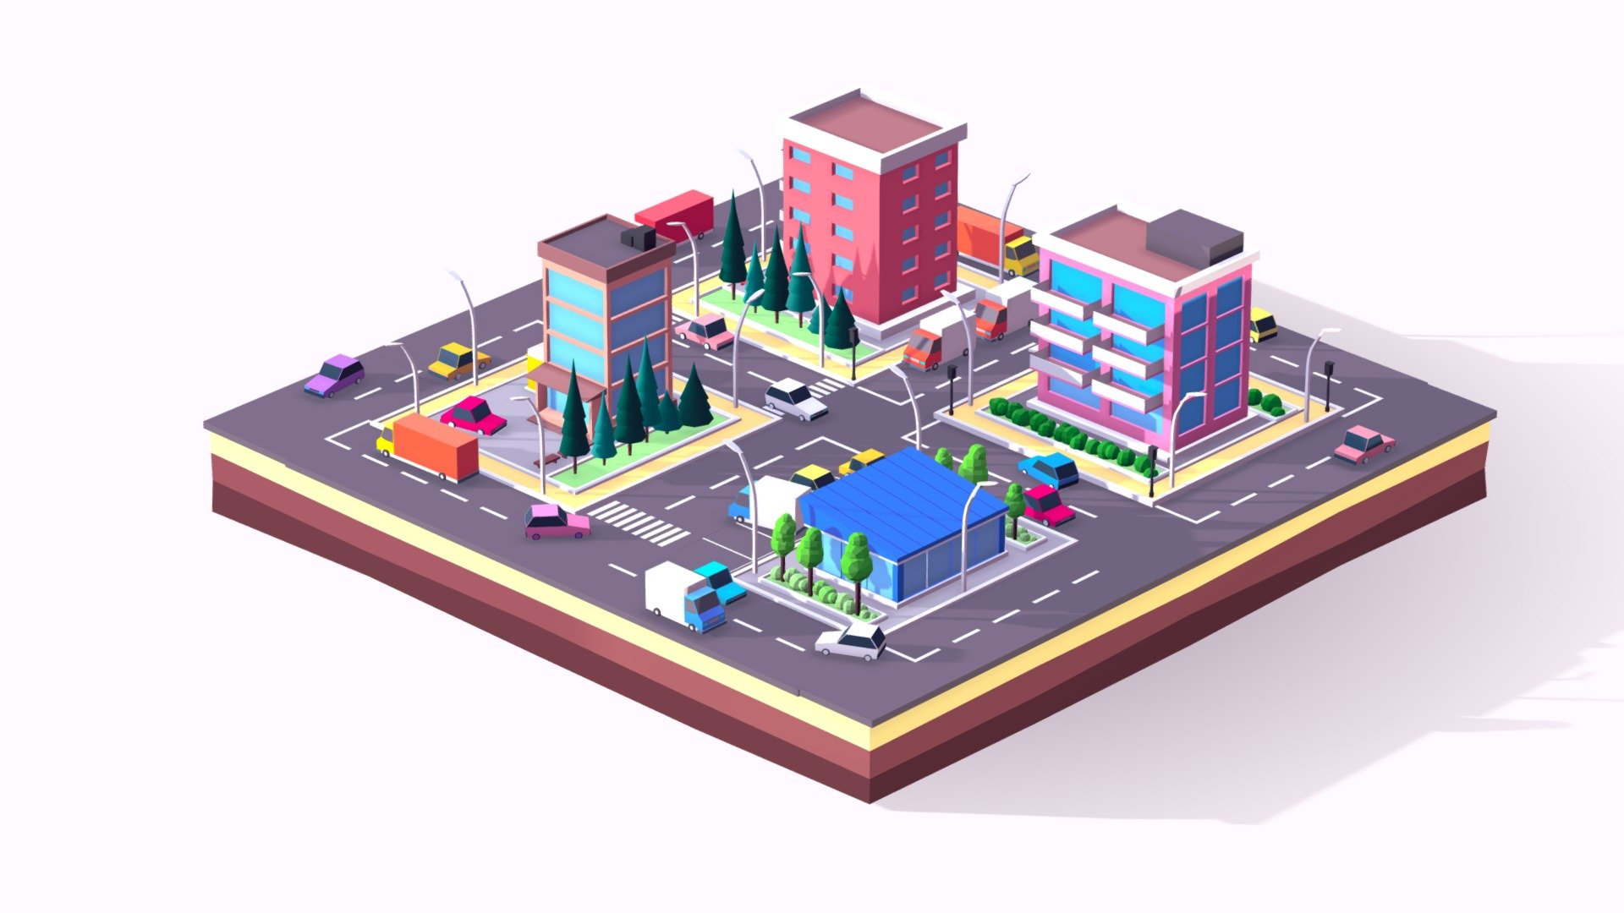
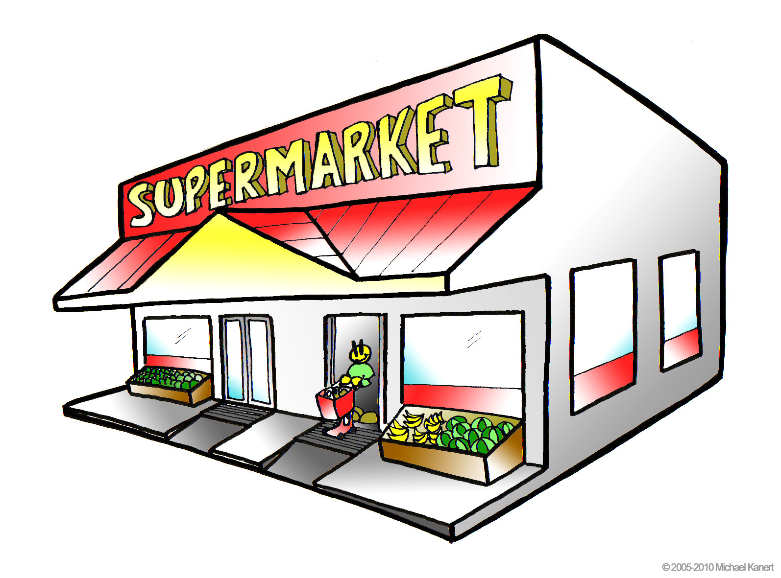


Y8 Topic 4 KNOWLEDGE ORGANISER: Mi Ciudad
New concepts and skills
Using the verb “ir”.
Describing types towns and cities.
Using adverbs of position and prepositions of place.
Use of "hay" vs. "está/están"
Assessment
End of Topic Assessment
Key questions
¿Qué hay en tu ciudad?
¿Adónde vas en tu ciudad?
¿Por dónde se va al supermercado?
¿Qué vas a hacer el fin de semana?
Links to prior learning
The verbs “hay” and “es”
The difference between “el”, “la”, “los” and “las”.
Conjugating present tense verbs.
Using adjectives to describe places and things
Useful verbs:
ir – to go (present tense)
I go | voy
you go | vas
he/she goes | va
we go | vamos
you pl. go | vais
they go | van
CEIAG Links
Urban Planner
Employability skill:
To be successful in this industry you will need to be able to interpret data, maps, and statistical reports.
This Photo by Unknown Author is licensed under CC BY-NC-ND

