Slide 1
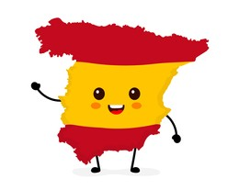

Y8 Topic 3 KNOWLEDGE ORGANISER: Mi Casa
New concepts and skills
Using the verb “vivir”.
Describing types of houses and rooms.
Using adverbs of position and prepositions of place.
Using the verbs “es” and “está” correctly.
Conditional phrases using “me gustaría” and infinitive verbs.
antiguo/a histórico/a moderno/a las afueras la aldea el campo el centro la ciudad la costa el desierto la isla el mar la montaña la playa el pueblo vivir la zona la brújula el este el noreste el noroeste el norte el oeste los puntos cardinales el sur el sureste el suroeste | old historic modern outskirts village countryside centre city coast desert island sea mountain(s) beach town to live area compass east northeast northwest north west compass points south southeast southwest
Assessment
End Of Year Assessment
→Listening, Reading, Dictation & Writing
Key questions
¿Dónde vives?
¿Cómo es tu casa?
¿Cómo es tu habitación?
¿Dónde te gustaría vivir?
Links to prior learning
Conjugating present tense verbs.
Using adjectives to describe places and things
The verbs “hay” and “es”
The difference between “el”, “la”, “los” and “las”.
CEIAG Links
Architecture, Construction & Engineering
Employability skill:
To be successful in these industries you will need to be creative, innovative and work positively with clients.

