Slide 1
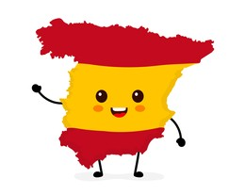

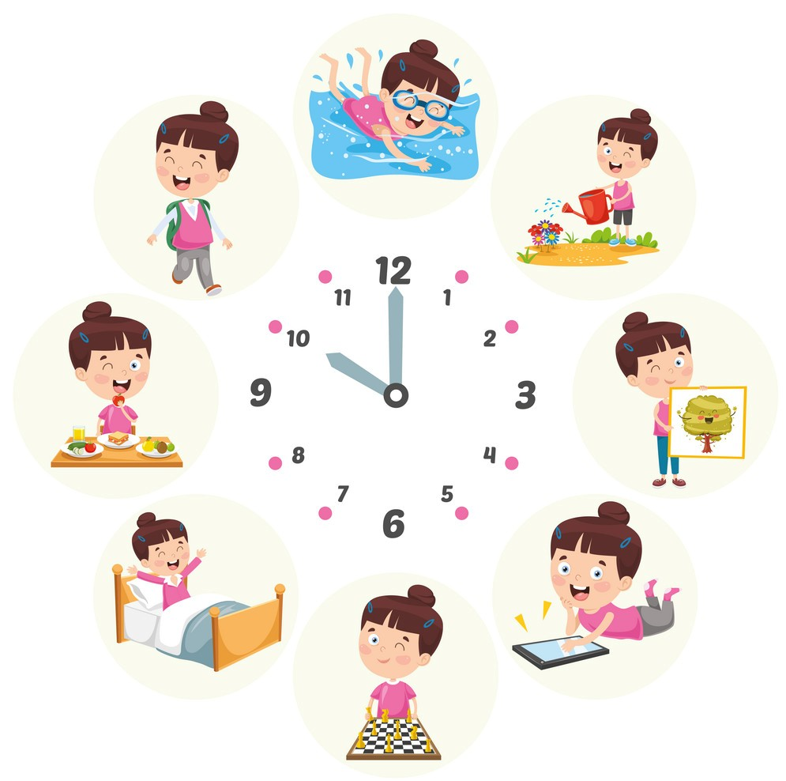
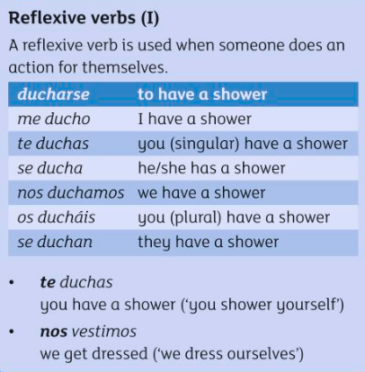
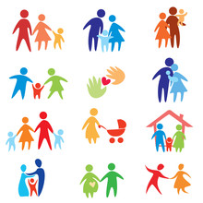
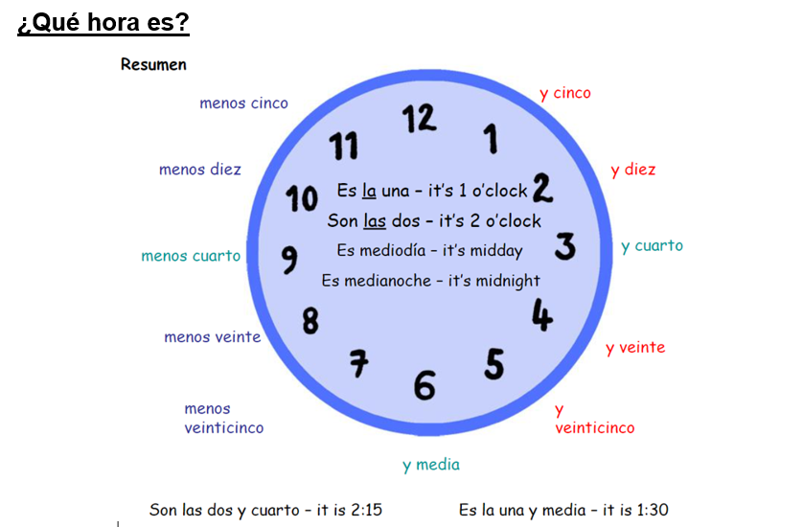
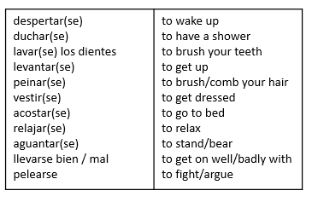
Y8 Topic 1 KNOWLEDGE ORGANISER: Yo y los otros
New concepts and skills
Describing relationships
Telling the time
Using reflexive verbs
Describing our daily routines
Reflexive verbs
Assessment
Key piece with individual written teacher feedback on mini paragraph Mi familia.
Grammar Assessment – Reflexive verbs
Key questions
1. ¿Hablas de tus relaciones con tus amigos y con tu familia?
2. ¿Qué hora es?
3. ¿Qué es tu rutina diaria por la mañana?
4. ¿Qué es tu rutina diaria por la tarde?
¿Qué hora es?
What time is it?
Links to prior learning
Family members - Physical descriptions
Numbers - Age - Colours
Adjectival Agreement - Opinions
CEIAG Links
Healthcare, Social Work & Counselling
Employability skill:
To be successful in these industries you will need to have excellent communication and build positive relationships.

