Slide 1


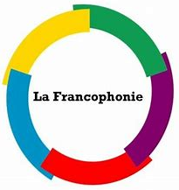

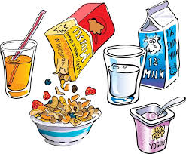
Y8 Topic 3 KNOWLEDGE ORGANISER: Le monde francophone
New concepts and skills
- To talk about nationalities, where you live and the languages you speak & use prepositions with countries and towns.
- To learn about classic dishes from Francophone countries.
- To use expressions with Avoir. (I have thirst)
- To listen and read passages, identifying relevant information.
- To translate / write extended passages and discuss future plans using the ‘true’ future tense.
New vocabulary
J'ai faim - I’m hungry
J'ai soif - I’m thirsty
Tu as raison - You’re right
Ça a l'air délicieux. - It looks delicious
À l'avenir... - In the future…
Plus tard... - Later…
je ne regretterai rien – I will regret nothing
Key verbs
je suis (I am) je mange (I eat)
j’habite (I live) je vais (I’m going)
Assessment
EOY Assessment
→Listening, Reading & Dictation
End of Topic Assessment→
Listening, Reading & Translation
Key questions
Tu es de quelle nationalité?
Qu’est-ce que tu prends au petit-déjeuner?
Qu’est-ce que tu vas prendre?
Et à l’avenir?
CEIAG Links
Nationalities, Countries & Languages
- Career: Diplomatic Service e.g., ambassador, embassy staff.
- Skills: Intercultural Communication – Crucial for fostering international relations and understanding diversity.
Francophone Hospitality, Leisure and Tourism
- Career: e.g., chef, food critic, travel guides, hotel managers, restaurant staff.
- Skills: To succeed in these industries you need to be organised, adaptable and helpful. You also need to embrace learning about new cultures.
Prendre – to take (have with food & drink)
Je prends
Tu prends
Il/elle prend
Nous prenons
Vous prennez
Ils prennent
Avoir – To have (also use with age)
J’ai
Tu as
Il/elle/on a
Nous avons
Vous avez
Ils/elles ont
Links to prior learning
Consecutive verb rule – je veux / je voudrais + infinitive.
French culture - Francophone countries / languages / traditional foods.

