Slide 1
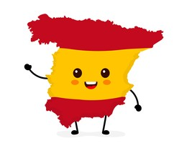

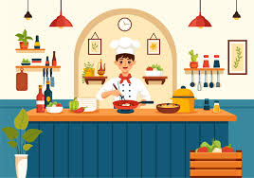
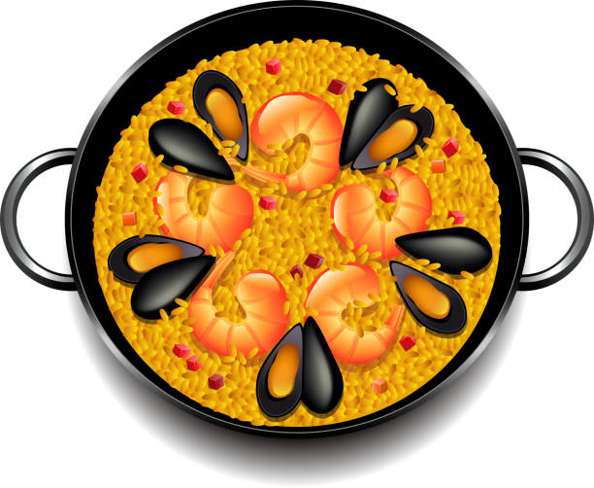


Y7 Topic 3 KNOWLEDGE ORGANISER: Mi comida preferida
New concepts and skills
Mealtimes in Spain
Speaking by performing a scenario in a restaurant
Difference between
tú and usted
New verbs
Desayunar – to have breakfast
Almorzar – to have lunch
Merendar – to snack
Cenar – to have evening meal
Tú = You singular (informal)
Usted = You plural (formal)
Key verbs
Assessment
End of year Assessment – Listening, Reading, Dictation & Translation
Key questions
1. ¿Qué comes?
2. ¿Qué quieres?
3. ¿Eres sano?
Pronoun | Comer (to eat) | Beber (to drink)
yo (I) | Como | Bebo
tu (you) | Comes | Bebes
él/ella (he/she) | Come | Bebe
nosotros (we) | Comemos | Bebemos
vosotros (you pl) | Coméis | Bebeis
ellos/ellas (they) | Comen | Beben
Links to prior learning
- Word classes (nouns, verbs, pronouns, adjectives)
- Adjectival agreement (singular and plural)
- Cognates
- Use of ‘gustar’
- Present tense verbs
CEIAG Link
Hospitality, leisure & tourism
You will use your organisational skills and demonstrate that you can be adaptable and helpful.
Abroad you will also need to be willing to learn about new cultures and appreciate new things.

