Slide 1
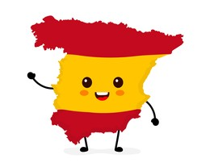



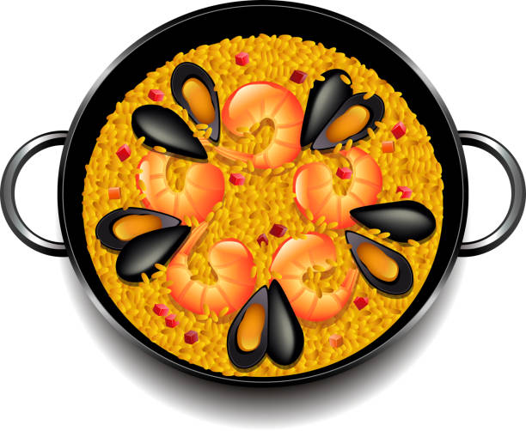
Y7 Topic 3 KNOWLEDGE ORGANISER: Mi comida preferida
New concepts and skills
To understand meal times in Spain.
To develop speaking skills by performing a scenario in a restaurant.
To understand the difference between tú and usted.
New vocabulary
Tú- you singular (informal)
Usted- you singular (formal)
Key verbs
Assessment
End Of Year Assessment
→Listening, Reading, Dictation & Writing
End of Topic Assessment
Key questions
1. ¿Qué comes?
2. ¿Qué quieres?
3. ¿Eres sano?
Pronoun | Comer (to eat) | Beber (to drink)
yo (I) | Como | Bebo
tu (you) | Comes | Bebes
él/ella (he/she) | Come | Bebe
nosotros (we) | Comemos | Bebemos
vosotros (you pl) | Coméis | Bebeis
ellos/ellas (they) | Comen | Beben
Links to prior learning
Word classes (nouns, verbs, pronouns, adjectives)
Adjectival agreement, singular and plural
Cognates
Use of ‘gustar’
Present tense conjugations
CEIAG Links
Hospitality, Leisure and Tourism
- Career: e.g., chef, food critic, travel guides, hotel managers, restaurant staff.
- Skills: To succeed in these industries you need to be organised, adaptable and helpful. You also need to embrace learning about new cultures.

