Slide 1
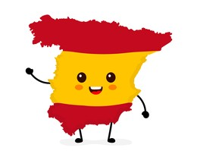

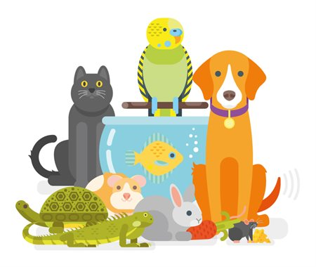
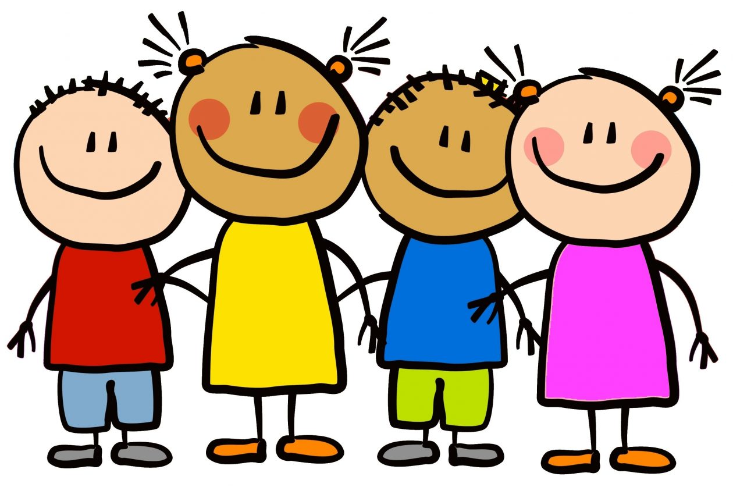
Y7 Topic 1 KNOWLEDGE ORGANISER: Me presento
New concepts and skills
Cognates – words that look similar and mean the same thing in Spanish and English.
Adjectival agreement – when an adjective changes depending on whether the noun it describes is masculine or feminine, or singular or plural.
Phonics in Spanish – some letters correspond to different sounds in English and Spanish –
c, g, h, j, ll, ñ, qu, v, z.
Gender – in Spanish all nouns are either masculine or feminine. This is a way of classifying nouns and it does not equal male or female.
New vocabulary
Las mascotas - pets
Los números - numbers
Los meses del año – months of the year
Assessment
Key piece with individual written teacher feedback on writing task Me presento with next steps
End of Topic Assessment
→Listening, Reading & Translation
Grammar Assessment
& Translation
Grammar Assessment
llamarse | to be called
me llamo | my name is
te llamas | your name is
se llama | his/her name is
CEIAG Links
Tourism & Hospitality: Hotel staff, tour guides, and restaurant staff frequently greet and introduce themselves to guests.
Employability skill:
Communication: You will need to introduce yourself in each new job.
Pronouns | Ser (to be) | Tener (to have)
I (yo) | Soy | Tengo
You sing (tu) | Eres | Tienes
He/she (el/ ella) | Es | Tiene
We (nosotros) | Somos | Tenemos
You pl (vosotros) | Sois | Teneis
They (ellos/ ellas) | Son | Tienen
Links to prior learning
Word classes
Noun – a naming word, e.g. “dog”, “cat”.
Pronoun – a word that replaces a noun in a sentence, e.g. “he”, “they” or “it”.
Verb – a doing word, e.g. “ to be”, “to have”.
Adjective – a word that describes a noun, e.g. “clever”, “Spanish”, “blue”

