Slide 1


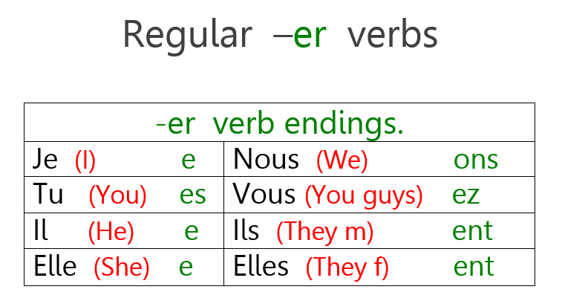




Y7 Topic 3 KNOWLEDGE ORGANISER: Moi, et mes trucs à moi
New concepts and skills
Hobbies & interests.
Cognates & near cognates.
Opinions with reasons.
Regular ER verbs in the present tense.
Animal descriptions and prepositions.
Pronounciation of new vocabulary using phonics.
Grammar
Key verbs
Aimer = To like
Détester = To hate
Trouver = To find
Préférer = To prefer
Assessment
Grammar Assessment
End Of Year Assessment
→Listening, Reading, Dictation & Writing
Key questions
1. C’est quoi, ton truc?
2. Tu aimes quoi? Tu n’aimes pas quoi?
3. C’est quoi, ton animal préférée?
CEIAG Links
Sports and Physical Activities e.g. Athlete,
Coach, PT, Event Coordinator
Music and Performing Arts e.g. Musician, Music Producer
Art and Craft e.g. Illustrator, Graphic Designer, Fashion Designer
Digital Hobbies e.g. Video Game Developer/Designer, Software Engineer
IT Specialist, AI Specialist
Getting involved in enrichment activities help you to develop transferable skills.
Links to prior learning
Grammar - Word classes (nouns, adjectives, verbs, infinitives, cognates, personal pronouns, definite & indefinite articles)
Adjectival agreement rules

