Slide 1


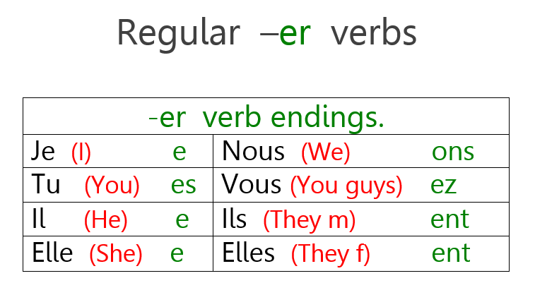




Y7 Topic 3 KNOWLEDGE ORGANISER: Moi, et mes trucs à moi
New concepts and skills
Hobbies & interests
Opinions with reasons
Regular ER verbs in the present tense
Animal descriptions and prepositions
Pronounciation of new vocabulary using phonics
Grammar
Key verbs
Aimer = To like
Détester = To hate
Trouver = To find
Préférer = To prefer
Assessment
Grammar Assessment
End Of Year Assessment
→Listening, Reading, Dictation & Writing
Key questions
1. C’est quoi, ton truc?
2. Tu aimes quoi? Tu n’aimes pas quoi?
3. C’est quoi, ton animal préférée?
CEIAG Links
Sports and Physical Activities e.g. Athlete,
Coach, PT, Event Coordinator
Music and Performing Arts e.g. Musician, Music Producer
Art and Craft e.g. Illustrator, Graphic Designer, Fashion Designer
Digital Hobbies e.g. Video Game Developer/Designer, Software Engineer
IT Specialist, AI Specialist
Getting involved in enrichment activities help you to develop transferable skills.
Links to prior learning
Grammar - Word classes (nouns, adjectives, verbs, infinitives, cognates, personal pronouns, definite & indefinite articles)
Adjectival agreement rules

