Slide 1


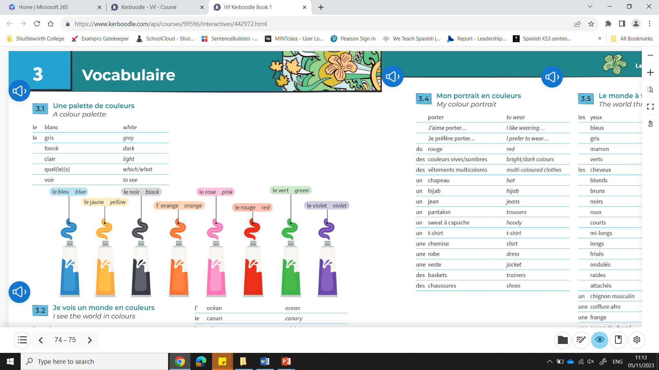
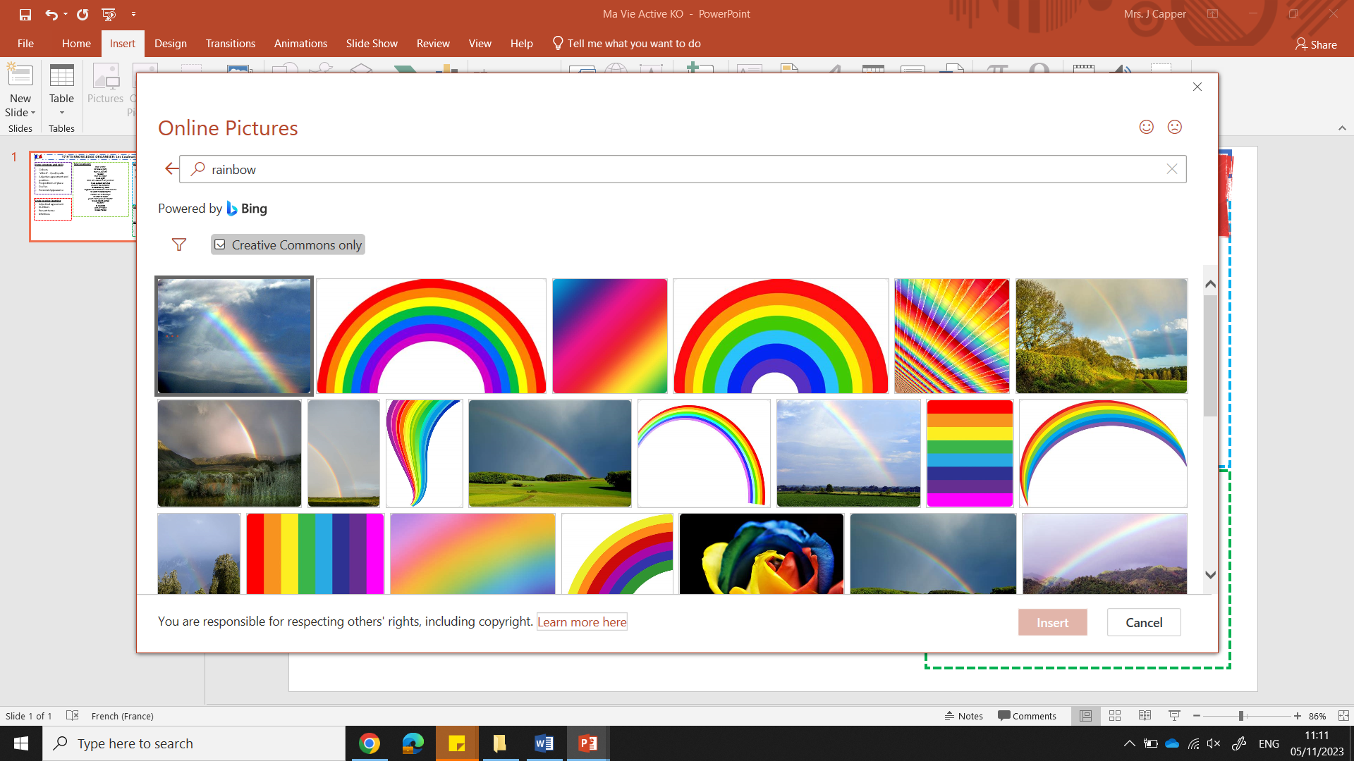
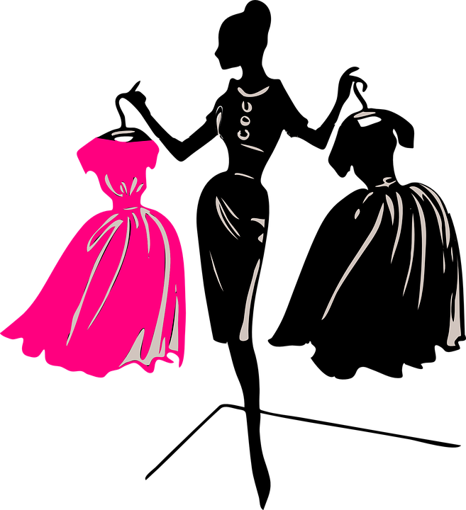
Y7 Topic 2 KNOWLEDGE ORGANISER: Les Couleurs du Monde
New concepts and skills
Colours
‘Which’ - Quel/quelle
Voir = to see
Adjectival agreement and position
Items of clothing
Opinions
Physical descriptions (hair & eye colour)
New vocabulary
Assessment
End of Topic Assessment
→Listening, Reading & Translation
Mid-year assessment
→Listening, Reading & Dictation
CEIAG Links
Fashion & Design
Fashion Designer: Designing and creating clothes and understanding colours.
Stylist: Describing clothing and appearance accurately is a key skill.
Retail and Merchandising: Communicating product details..
Employability skill:
Attention to detail: You will observe and describe details so that others can clearly understand.
voir (to see)
je vois | I see
tu vois | you see (singular informal)
il/elle/on voit | he/she/one sees
nous voyons | we see
vous voyez | you see (plural or formal)
ils/elles voient | they see
Links to prior learning
Greetings
Introducing self & others
Numbers
Adjectives
Present tense ER verbs
e.g. habiter

