Slide 1





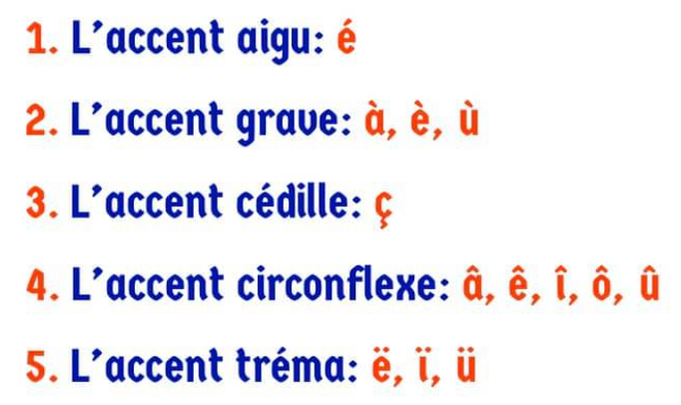
Y7 Topic 1 KNOWLEDGE ORGANISER: Je me présente
New concepts and skills
To identify cognates & semi-cognates.
To find ways to pronounce new vocabulary using phonics.
To learn classroom language and the alphabet.
To use accents in your written French.
To learn greetings and introductions including 5 key Q & A.
Grammar
Subject pronouns:
Je I
Tu You
(singular / informal)
Il / Elle He / She
Nous We
Vous You
(plural / formal)
Ils / Elles They
Useful verbs:
Je m’appelle I am called
Tu t’appelles You are called
Il / Elle s’appelle He / she is called
J’habite I live
Tu habites You live
Il / Elle habite He / she lives
Assessment
Verbal feedback on mini dialogues:
1. Comment t’appelles-tu?
What is your name?
2. Comment ça va?
How are you?
3. Quel âge as-tu?
How old are you?
4. Quelle est la date de ton anniversaire ?
What is the date of your birthday?
5. Où habites-tu?
Where do you live?
Key piece with individual written teacher feedback on mini paragraph Moi.
CEIAG Links
Tourism & Hospitality: Hotel staff, tour guides, and restaurant staff frequently greet and introduce themselves to guests.
Employability skill:
Communication: You will need to introduce yourself in each new job.
Links to prior learning
Grammar - Word classes (nouns, verbs, adjectives)
Alphabet
Numbers
French accents:

