Slide 1



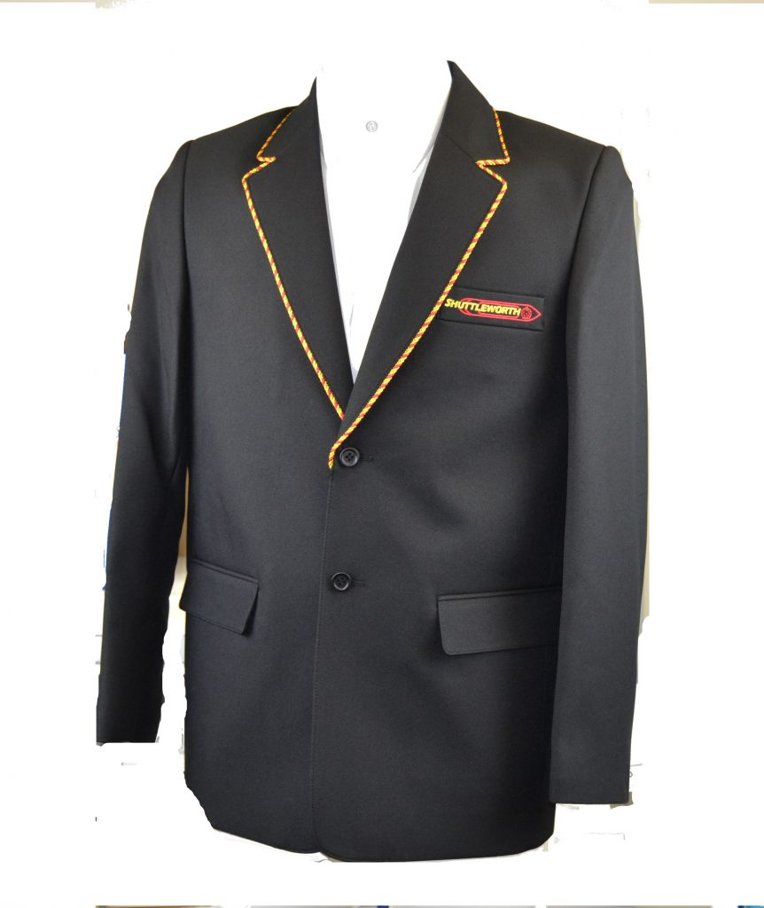

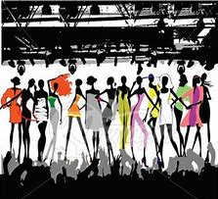
Y9 Topic 1 KNOWLEDGE ORGANISER: Les vêtements, la mode et le passé composé
New concepts and skills
Clothing vocabulary, including school uniform
How to form the passé composé (past tense)
Describe a visit to a festival or celebration
Answer questions in 3 tenses
New vocabulary - Le passé composé
Past tense regular -ER verbs
développer ma confiance en moi
to develop my self-confidence
travailler pour une école verte
to work for a green school
vivre heureux ensemble
to live happy together
Assessment
Grammar Assessment End of Topic Assessment →Listening, Reading & Translation Key questions Qu’est-ce que tu portes normalement? Qu’est-ce que tu portes au collège? Qu’est-ce que tu porteras? *** Et le weekend dernier?
Avoir Choose WHO | Past participle É
J’ai | porté | I wore
Tu as | porté | You wore
Il / Elle / On a | porté | He / She / We wore
Nous avons | porté | We wore
Vous avez | porté | You guys wore
Ils / Elles ont | porté | They wore
CEIAG Links
Events Manager
SKILLS:
Organisation & Communication: Discussing client requirements.
Negotiation: Agreeing budgets & timescales.
Research: e.g. venues/materials, contacts & suppliers.
Advertising: Publicising the event & designs.
Links to prior learning
Present tense
Colours
Adjectival agreement
Time markers
Consecutive verb rule
e.g. je voudrais porter

