Slide 1
We have all had our session from East Lancashire learning, looking at Post 16 options.
What does ‘Post 16’ mean?
When you choose an apprenticeship, you get paid. True or false?
A levels are the best option if you want to go to university. True or false?
There is an option called C-Levels. True or false?
If you choose a vocational subject, you choose 1 subject. True or false?

Slide 2
We have all had our session from East Lancashire learning, looking at Post 16 options.
What does ‘Post 16’ mean? When you are 16+, after you leave Year 11.
When you choose an apprenticeship, you get paid. True or false?
A levels are the best option if you want to go to university. True or false?
There is an option called C-Levels. True or false?
If you choose a vocational subject, you choose 1 subject. True or false?
Notes:
3. Please remind students that there is no one size fits all. You can go to university through a variety of routes which will be explored today.
4. T levels not C levels.

Slide 3
Unit: Careers
Study Skills
Setting goals
Post 16 options
Work and beyond
Post 16
What are the main Post-16 qualifications and options?
The main Post-16 pathways: A-levels/Vocational courses (BTECs, T Levels)/Apprenticeships/Specialist colleges or training/What university is and what degrees are.
How entry requirements work (GCSEs → Post-16 → university).
How careers, skills, and qualifications link together.
Exploring which Post-16 route might suit us.
Matching career ambitions to qualification pathways.
Notes:
Second lesson in the unit. REALLY IMPORTANT to understand that your life does not have to be planned out in year 9
Misconceptions to look out for: University is the only route to a good career.
Apprenticeships are only for practical jobs.
You must pick your future career immediately.
Post-16 choices never change once chosen.

Slide 4





Year 9: Choosing GCSE options recap!
Choosing your GCSE options
Preparing for your future
Starting to think about options after Year 11 (post-16 options)
Starting to think about higher education, training and employment options (post-18 options)
Don’t panic! We will support you through all of these decisions!

Slide 5
GCSEs
For each GCSE subject, you will receive a grade between 1-9
Grade 9 is the highest, Grade 4 is the equivalent to C
[Resits of GCSE English Language and Maths are required if students do not get a grade 4 or above at school]
Vocational subjects (BTEC / Cambridge National etc) have different grades, from Level 1 Pass to Level 2 Distinction* (Pass / Merit / Distinction / Distinction*)

Slide 6
What happens after Year 11 at Shuttleworth?
Every subject you do can help you progress in the future:
  Subject knowledge
  Skills
The more qualifications you earn, the more choice you have over what you do after Year 11:
  Places to study
  Subjects and level of qualification
  Type of assessment (Exam / coursework/ practical work)
  Type of employment
  Money you earn

Slide 7
What happens after Year 11 at Shuttleworth?
You aren’t making decisions about your post-16 options yet, so don’t worry!
This is just to show you what you will be working towards when you do your GCSEs.

Slide 8
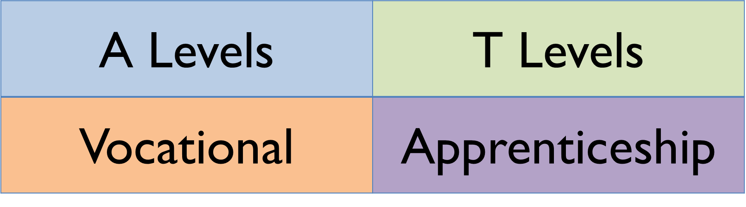
What are post-16 options?
There is no one option that suits everyone – this is your time to choose the option that suits you the best!
All of the options have positives and negatives.

Slide 9
A Levels How many subjects do you pick? What are the entry requirements? How are you assessed? What subjects can you choose? Give 4 examples. | T levels How many subjects do you pick? Where do you spend your time? What are the entry requirements? How are you assessed?
Vocational How many subjects do you study? What kind of subjects can you choose? What are the entry requirements? How are you assessed? | Apprenticeship What kinds of fields can you do apprenticeships in? What are some benefits of apprenticeships? What might be some drawbacks to apprenticeships?
Notes:
PRINT THIS FOR EACH STUDENTS
Carousel learning. Place information around the room from slides 10 – 17. May have to print multiple copies. Ask students to read information and answer the questions based on each post 16 route.
I would suggest 5 mins per option. 20 mins total.
Will still need going through to ensure students have understood the different options available.

Slide 10
A Levels (2 years)
You can choose 3-4 subjects, which tend to be more ‘traditional’
They are mainly theory-based, have less practical work
They are mainly assessed by exam at the end of the second year
You have to be prepared to work hard independently
Entry: you typically need at least 5 GCSEs at grade 5+, and some subjects ask for higher

Slide 11
A Levels
Ancient History | Dance | Film Studies | Media Studies
Art & Design | Drama | French | Physics
Biology | DT | Geography | Politics
Business Studies | Economics | Geology | Psychology
Chemistry | English Language | German | Religion & Philosophy
Classical Civilisation | English Literature | History | Spanish
Computer Science | English Combined L&L | Law | Sociology
Criminology | Environmental Science | Maths / Further Maths | Sport Science & PE
Each sixth form or college will have a different range of subjects on offer.

Slide 12
T Levels (2 years)
Newer! So there is a limited range of providers and subjects
You choose 1 main subject, but often specialise in Year 2
80% time in College, 20% on work placement
They are assessed by exam, coursework, practical and work placement
They have been developed with employers
Entry: You will need at least 5 GCSEs at grade 4-5, including GCSE English Language and Maths

Slide 13
T Levels
Agriculture & Land Management Land based engineering Livestock production Hosrticulture & Landscaping Arboriculture | Animal Care & Management Animal management & behaviour | Business Accounting Finance Legal services Management & Administration Marketing
Construction Design, Surveying & Planning Building services engineering | Digital Cyber Security Production, design & development Software Development | Education Early Years Educator Teaching Assistant
Engineering Civil Engineering Manufacturing, Design & Development Manufacturing, processing & control Machining & Toolmaking | Health Adult Nursing Children’s Nursing Mental Health Midwifery | Media Media Broadcast & Production
Each sixth form or college will have a different range of subjects on offer.

Slide 14
Vocational
You choose 1 subject, which leads into a work area
They are assessed mainly by ongoing coursework, with some exams and some practical work
There is often work placement to help you put your skills into practice
Entry: there are different levels to suit different GCSE results. Level 1 takes 1 year, Level 2 takes 1 year, Level 3 takes 2 years. The higher your results, the less time it takes!

Slide 15
Vocational
Agriculture | Computer Science | Hair & Beauty | Music
Animal Management | Construction | Health & Social Care | Performing Arts
Applied Science | Education & Early Years | Horticulture & Groundskeeping | Public Services
Art & Fashion | Engineering | Media Production | Sport
Business | Farriery | Motorsports | Travel & Tourism
Catering & Hospitality | Furniture | Motor Vehicle
Each sixth form or college will have a different range of subjects on offer.

Slide 16
Apprenticeship
You choose 1 subject
You work – a real job – for 80% of your time. Off the job training is 20%.
You get paid!
You won’t get school holidays any more
They are done with an employer in conjunction with a college or training provider
The application process is longer as there are also interviews with employers
Entry: requirements vary between courses and employers, but the higher you get, the better chance you have.

Slide 17
Apprenticeship
Accountancy | Catering & Hospitality | Hair & Barbering | Marketing & Media
Agriculture | Childcare | Health & Social Care | Motor Vehicle
Animal Studies | Construction | IT | Retail & Sales
Beauty Therapy | Contact Centre / Customer Service | Horticulture & Groundskeeping | Science
Business Administration | Engineering | Manufacturing | Sport & Fitness
Each college or training provider will have a different range of subjects on offer.

Slide 18
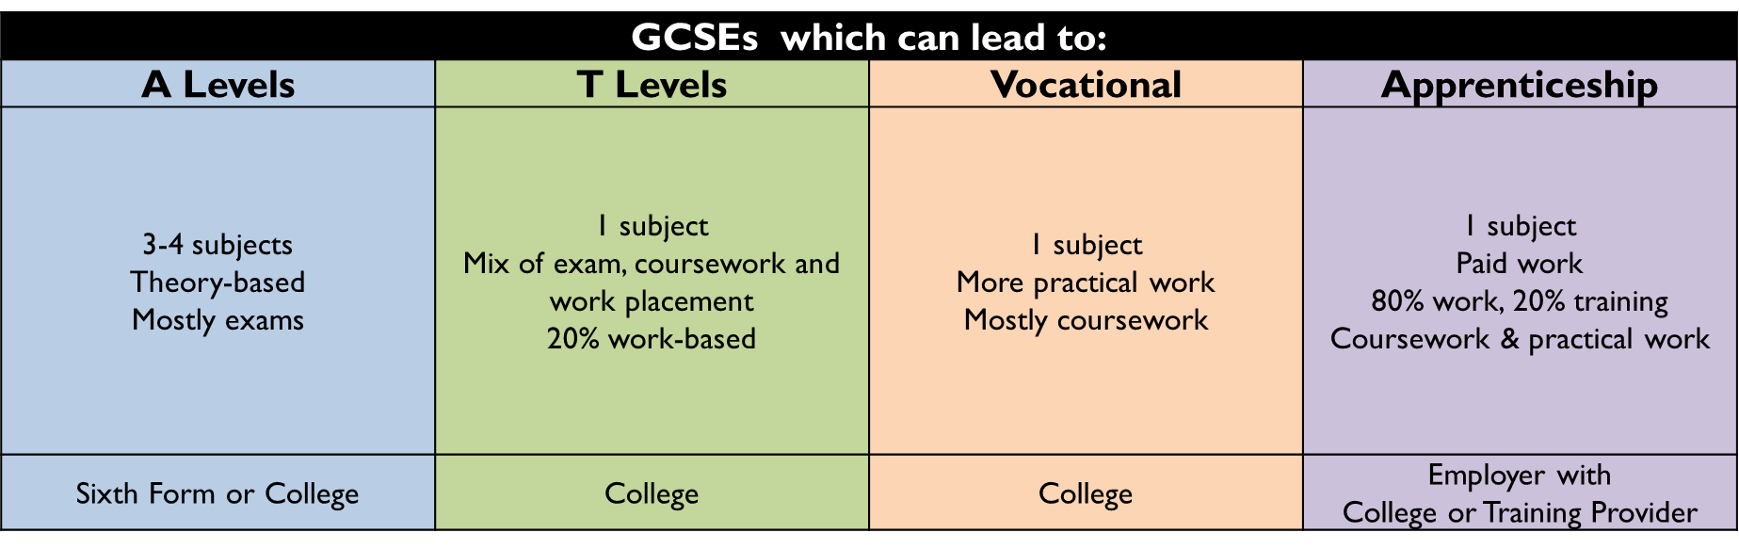
A summary of post-16 options

Slide 19
Choosing what is right for me
Instructions
1. Reading the information about the characters and their Post 16 options.
2. Choose the pathway you think would best suit the character and explain why.
Let’s have a look at one together…
Sam: ‘I have had enough of sitting in a classroom, I really want to go out and explore the real world. I have an interest in hair and beauty and love trying different hairstyles on my friends. I did enjoy PE and drama in school because I like being active and talking to others. I know that I don’t have to choose a career right now, but I would like to earn some cash whilst I learn.
Which pathway would suit Sam and why?
Notes:
Most would hopefully say an apprenticeship as they can earn some money along the way. Could be in sports/fitness; beauty; hairdressing.
Some could say vocational as more hands on.

Slide 20
Anna “Science and Maths are my favourite subjects and I usually do well in tests. I like understanding how things work and solving problems. I don’t mind exams and I’m happy to put extra time into studying at home. I think I might want a job in engineering, medicine or technology in the future, but I know that will take a long time.”
Instructions
1. Reading the information about the characters and their Post 16 options.
2. Choose the pathway you think would best suit the character and explain why.
Stephen “I like the idea of earning money and feeling independent as soon as possible. I don’t mind hard work and I’d rather learn by doing a real job than sitting in a classroom all day. I’m confident talking to adults and I like being part of a team. I know I won’t get long school holidays, but that doesn’t really bother me.”
Katie: “I much prefer practical lessons to sitting and listening. I really enjoyed Design Technology and Construction tasks because I like making things and seeing a finished product. Exams make me nervous, but I’m good at coursework when I can work at my own pace. I’d like a job where I can use my hands and maybe work on sites in the future.”
Al: I enjoy learning new ideas and I like lessons where we have to think deeply and discuss topics. English and History are my strongest subjects and I don’t mind revising for exams. I like working independently and I think I might want to go to university one day, but I’m not sure what for yet. I know I’ll need to stay motivated because I can procrastinate sometimes.”
Maddie “I enjoy creative subjects like Art and Media and I like expressing myself. I’m motivated when I’m working on projects I care about, but I don’t enjoy lots of exams. I’d like to work in a creative industry one day, but I know I’ll need the right skills and experience to get there.”
Notes:
Print and ask students to complete in books.
Anna – a levels
Katie – vocational
Al - A levels
Stephen – Apprenticeship
Maddie – T levels or vocational

Slide 21
Levels explained…
4+ | Degree / Foundation Degree / Higher Level & Degree Apprenticeship Full level 3 qualification
3 2 years | A Levels At least 5 GCSE grade 5s (6+ for certain subjects) | T Levels At least 5 GCSE grade 4-5s (inc. English & Maths) | Vocational At least 5 GCSE grade 4/5s | Advanced Apprenticeship At least 5 GCSE grade 4/5s
2 1 year | - | T Level Transition At least 2 GCSE grade 4/5s | Vocational At least 2 GCSE grade 4/5s (inc. English / Maths) | Intermediate Apprenticeship At least 2 GCSE grade 4/5s (inc. English / Maths)
1 1 year | - | - | Vocational At least 2 GCSE grade 3s (inc. English / Maths) | -
Entry 1 year |  |  | Vocational Individual entry requirements

Slide 22
What happens after post-16?
Remember: One step at a time…
GCSEs which can lead to:
A Levels | T Levels |  | Vocational |  | Apprenticeship
Which could all lead to:
University Degree |  | Apprenticeship Higher or Degree |  | Employment

Slide 23
Don’t panic
You are not making any final decisions today.
You will be supported to make your GCSE Options choices over this term.

Slide 24
Where can you find more information?
Speak to Mrs Ackroyd, Careers Leader – the Careers Office is in the atrium or email fackroyd@shuttleworth.lancs.sch.uk
  No question is too small
  You are not expected to know everything
Teachers!
Use the Careers section in the library
Use sixth form, college and apprenticeship provider websites and social media channels. Visit them in person
BBC Bitesize Careers
Lots of information and links are available on our website: www.shuttleworthcollege.org/curriculum/careers

