Slide 1
Mini whiteboards:
List 3 things which are included in a positive friendship
Define empathy
What is bullying
What are bystanders

Slide 2
In your books, front or back – does not have to be full sentences.
1. What do we understand by the term 'bullying’?
2. What impact can it have?
3. What are bystanders and how can they prevent or respond to bullying?
4. What support is there for people affected by bullying in any way?

Slide 3
Positive emotions
Friendships
Relationships
Mental health
Keeping safe
Bullying and bystanders
To learn about bullying in all its forms and how to prevent or challenge it.
Identify bullying in all its forms and the potential impact on those involved
describe skills and strategies to prevent bullying
Explain how and where to communicate concerns about friendships and bullying, including online.
Notes:
Introduce the learning objective and outcomes and explain that today’s lesson will be about identifying bullying in all its forms and considering the impact this can have on the people involved. Explain that students will also consider what positive relationships are like and how empathy can reduce bullying, along with identifying the support available should it occur.

Slide 4
KEY WORDS:
Bullying
When a person or group has power over another person and repeatedly hurts them in a verbal, physical or psychological way.
It can happen face-to-face or online and is repeated and intentional.
Bystander
A person who sees something happening but is not involved.

Slide 5
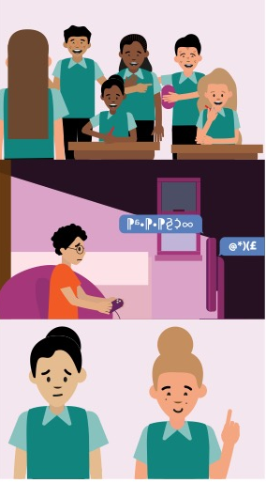


Is it bullying?
As a class we will read each scenario and in pairs you will discuss whether you think it is an example of bullying or not.
Write down the reasons for your decisions.
Notes:
Teacher notes – Is it bullying? (15 mins)
Ask students to read Resource 1 Is it bullying? in pairs and identify whether they think each scenario is bullying or not, recording the reasons for their decisions on the resource.
Support:
Ask students to use Resource 1a What bullying might look like, which only includes the bullying scenarios, uses simplified language and asks students to discuss why each is an example of bullying behaviour.

Slide 6
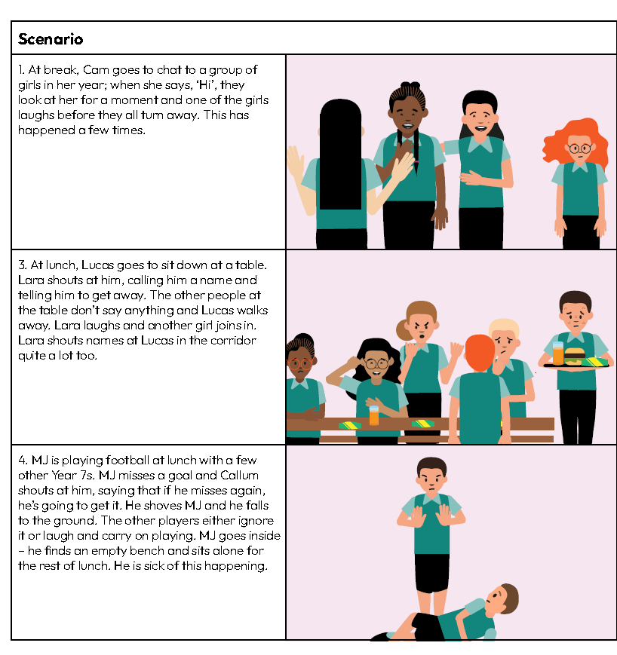
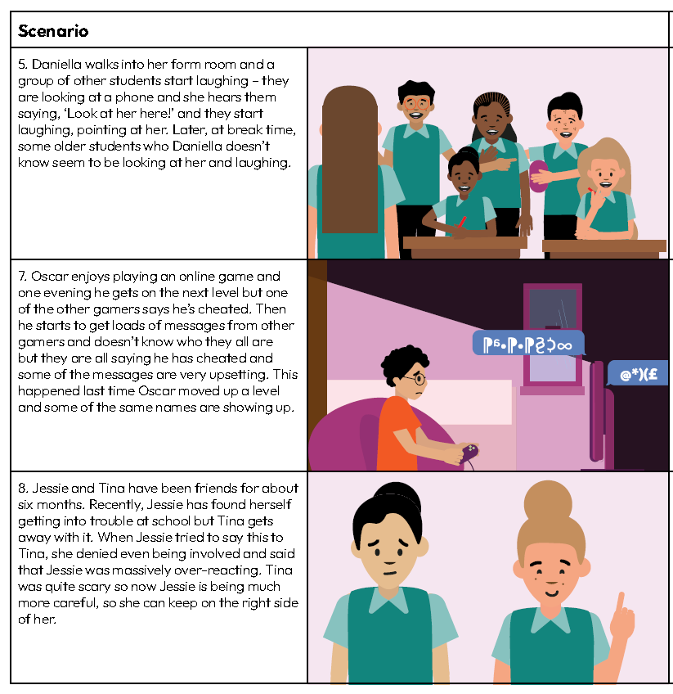
Notes:
Scenario 1: Bullying – repeated social exclusion.
Scenario 3: Bullying – repeated verbal abuse and social exclusion. Some of the other students sitting at the table also display bullying behaviour as they laugh when Lara is rude to Lucas.
Scenario 4: Verbal and physical bullying that is repeated, intimidation and further threat of violence.
Scenario 5: Bullying, cyberbullying, rumours, possibly sharing images without consent. Explain that those engaging with the content on the phone are displaying bullying behaviours.
Scenario 7: Online repeated bullying. This highlights that bullies may, or may not, be people known to the person.
Scenario 8: Bullying in the form of manipulation. Explain that bullying behaviours can come from someone who is seen as a friend. Manipulation means having a harmful influence over another person.

Slide 7
How can we tell it is bullying?
Social exclusion
Threats of violence
Joining in with bullying behaviour
Verbal abuse
Sharing images without consent
Manipulating
Physical harm
Repeated
Notes:
Teacher notes – Is it bullying? (15 mins)
Take feedback, drawing out key learning below and on this slide, which highlights some of the features of bullying seen in the scenarios:
Scenario 1: Bullying – repeated social exclusion.
Scenario 2: Probably not bullying. Reuban is withdrawn, there might be a reason that Mark could ask about – communication and empathy are needed here.
Scenario 3: Bullying – repeated verbal abuse and social exclusion. Some of the other students sitting at the table also display bullying behaviour as they laugh when Lara is rude to Lucas.
Scenario 4: Verbal and physical bullying that is repeated, intimidation and further threat of violence.
Scenario 5: Bullying, cyberbullying, rumours, possibly sharing images without consent. Explain that those engaging with the content on the phone are displaying bullying behaviours.
Scenario 6: Not bullying – Cheryl appears to be lashing out with anger – there could be something happening in Cheryl’s life. Alina needs to check-in with her friend and ask her if she is ok – communication and empathy needed here along with self-advocacy (standing up for herself) to say it is not ok for Cheryl to shout at her.
Scenario 7: Online repeated bullying. This highlights that bullies may, or may not, be people known to the person.
Scenario 8: Bullying in the form of manipulation. Explain that bullying behaviours can come from someone who is seen as a friend. Manipulation means having a harmful influence over another person.
Scenario 1: Bullying – repeated social exclusion.
Scenario 3: Bullying – repeated verbal abuse and social exclusion. Some of the other students sitting at the table also display bullying behaviour as they laugh when Lara is rude to Lucas.
Scenario 4: Verbal and physical bullying that is repeated, intimidation and further threat of violence.
Scenario 5: Bullying, cyberbullying, rumours, possibly sharing images without consent. Explain that those engaging with the content on the phone are displaying bullying behaviours.
Scenario 7: Online repeated bullying. This highlights that bullies may, or may not, be people known to the person.
Scenario 8: Bullying in the form of manipulation. Explain that bullying behaviours can come from someone who is seen as a friend. Manipulation means having a harmful influence over another person.

Slide 8

What impact might
bullying have?
Notes:
Teacher notes – The impact of bullying (5 mins)
Next, ask the pairs to discuss the scenarios that involved bullying behaviour again (scenarios 1, 3, 4, 5, 7, 8) and discuss what they think the impact of this behaviour might have been on the person who experienced it.
Take feedback and draw out key learning:
Bullying can have a significant impact on people’s mental health and sometimes people can develop harmful coping strategies to try to deal with the impact, which can make the situation worse.
It is important that someone who experiences bullying knows there is support for them and how to get that support.
Tell students that part of this lesson involves learning about the support available.

Slide 9

Sources of support
I need your help with something . . .
Speak to a tutor, head of year or other trusted staff member in school.
Contact:
Childline, www.childline.org.uk 0800 1111
Kidscape, www.kidscape.org.uk
Anna Freud, www.annafreud.org/on-my-mind
Something's worrying me,
can I talk to you?
I have something that’s been bothering me . . .
Notes:
Teacher notes – Sources of support (10 mins)
Share sources of support on this slide (including face-to-face, online, phone, home, school), briefly explaining what would happen if a student contacted each of these different sources. For example, Childline can be contacted online or by phone at any time and the conversation is between the counsellor and young person getting in touch. Anna Freud have a Youth Wellbeing Directory, text support line and self-care strategies to support young people. Kidscape have advice for young people effected by bullying behaviour.

Slide 10

Advice for Year 7 next year
Recommend a source of support for them if they are worried that a friendship may be unhealthy and explain what will happen if they contact this source.
Recommend a source of support if they are concerned about bullying and explain what will happen if they contact that source.
Notes:
Teacher notes – Sources of support (10 mins)
In their books, ask students to write to a student starting year 7 at their school next year, giving advice about where to find support for friendship or bullying concerns.

Slide 11
Endpoint assessment
Revisit the questions from the start of the lesson.
Using a different colour pen, add any additional learning in response to the four questions.
Have you achieved the learning outcomes?
Notes:
Teacher notes – Reflection and endpoint assessment (5 mins)
Ask students to revisit the graffiti walls from the baseline assessment. Using a different colour pen, ask them to add anything new they have learnt in response to the four questions, to demonstrate that they have achieved the learning outcomes. Remind them that the learning outcomes for the lesson related to identifying bullying in all its forms, the potential impact it can have on those involved, skills and strategies to prevent bullying, along with how and where to communicate concerns about friendships and bullying, including online.
This endpoint assessment will provide information about students’ progress and identify any gaps in learning that still need to be addressed.

Slide 12

Extension activity
Write a letter to the headteacher explaining what you think could be done to further reduce bullying in school.
Use these prompts to help you:
Is there anything that could be changed about the school environment (corridors, school toilets, canteen, playground)?
Is there anything that could be done differently at break and lunch times?
How could people behave differently (students, teachers, supervisors)?
How does the school respond to bullying? Could these systems be more effective?
Are there any other ideas you can think of (schemes like buddy/peer mentors)?
Notes:
Teacher notes – Extension activity
Ask students to write a letter to the headteacher explaining what they think could be done to further reduce bullying in school. Encourage students to reflect on aspects of school life that might influence bullying behaviours, using the questions as prompts.

