Slide 1
Where are we now?
Definition of intimacy
Examples of intimacy
On your own, complete the four corners activity.
What do you already understand about intimacy?
Signs a person is not comfortable
Signs a person is comfortable
Notes:
Teacher Notes - Baseline assessment (10mins)
Working on their own, ask students to complete a four corners grid focused on the term ‘intimacy’. Students could use Resource 1: Four corners or divide a page in their exercise books into four and use the following headings:
Definition of intimacy
Examples of intimacy
Signs a person is comfortable with the intimacy
Signs a person is not comfortable with the intimacy
As this is a baseline activity, students should complete this individually and with minimal or no support or prompting. It should reconnect them to previous learning about consent and demonstrate what they already know and believe about intimate relationships.
Either circulate around the room whilst students are working, to gauge their understanding, or take some brief feedback and collate key ideas on the whiteboard.

Slide 2
Unit: Love and relationships: Healthy romantic relationships
Keeping safe
Healthy lifestyles/relationships
Healthy romantic relationships
Safe relationships and sexual health
Families, fertility and pregnancy
The role of intimacy and pleasure
To learn about the role of intimacy, readiness, and pleasure in consensual relationships.
Recognise what enthusiastic consent looks and feels like
Assess the importance of readiness for intimacy as an individual and as a couple
Explain the role that communication and respect play in healthy relationships and consent
Notes:
The first unit in Year 10 starts with Love and Relationships, with a focus on healthy romantic relationships, with specific reference to RSHE concepts: consent, pressure, the impact of pornography and laws surrounding relationships. They did end Year 9 with 3 lessons on healthy relationships, looking at relationship values, contraception and managing breakups.

Slide 3



Building intimacy
Working in partners, look at the intimacy cards and order the cards, from the first steps of building intimacy, up to the most intimate.
There are 24 cards. You can:
Put several cards at the same stage
Put an X on any cards you don’t agree with (up to 10)
Try to reach an agreement about where to place the cards
Notes:
Teacher notes – Building intimacy (10mins)
Working in partners, hand students Resource 2: Intimacy cards and ask them to imagine a couple who are getting together and are just beginning to become intimate together. Ask them to order the cards, from the first steps of building intimacy, up to the most intimate. There are 24 cards all together; make clear they may choose to put several cards at a similar stage, and they don’t have to use them all (they might choose to put aside up to 10 cards) but they will need to try to come to an agreement and justify their decisions.
Support: Reduce the number of cards for students to order; select six from the physical intimacy cards and six from the emotional intimacy cards.
Challenge: Ask students to suggest some of their own ‘intimacy cards’ to add to those provided on Resource 2.

Slide 4
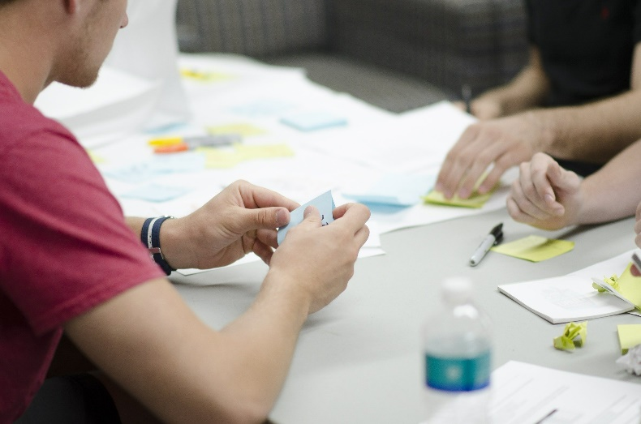
Comparing our views
Let’s see what other groups thought.
Leave your cards where they are and move round to see how other tables ordered the cards.
Once you have returned to your seats, discuss with your partner:
Which cards (if any) did your group choose to reject and why?
Did you notice any differences between how different groups organised the cards?
Was it easy or hard to agree on how to order the cards? Why do you think this is?
Which is harder to establish - physical intimacy or emotional intimacy?
Why does building intimacy take time?
Notes:
Teacher notes – Comparing our views (10mins)
Ask students to leave their cards laid out in order and to then go around the room looking at how others have organised the cards. Return to their original places and discuss the questions on the slide.
Take feedback, ensuring the following key learning is highlighted:
Groups are likely to have chosen to reject different cards, and to place cards in different orders. This demonstrates the differences everyone feels about physical and emotional intimacy. Some groups will have prioritised emotional intimacy before moving to physical intimacy. There will be some things that some people won’t like /will always feel uncomfortable with and will never want to be intimate in that way with someone else.
Everyone has different preferences, boundaries, and things they do/don’t enjoy, and every relationship progresses differently, so there isn’t a particular road map we should expect all relationships to follow. In some cultures and religions, sexual intimacy in relationships is not encouraged before marriage. Some people may also prefer to wait for a permanent, committed relationship, irrespective of religious or cultural beliefs.
Building intimacy takes a long time and should not be rushed. There will be some aspects of intimacy that might take months or years to build between two people. This is why couples should take time to get to know each other, and not make assumptions about what someone might want/like or not want/like when getting to know each other.

Slide 5
Enthusiastic consent
The following scenarios show examples of someone giving enthusiastic consent:
Ty and Jamie say they love each other and they both kiss for a long time before they both feel ready to go further.
Greg’s partner asks “How does that feel?”
He says; “Keep going. That feels good.”
Suzanna asks Mali “Do you like this?”
Mali moans with pleasure and says “Yes!”
Alexis and Gia have spoken about contraception and gone to get some together. They are laughing, smiling, kissing and decide to take things further.
TASK: Read the scenarios on your sheet that gives examples of someone not giving enthusiastic consent. Explain why the characters have not given consent in each scenario.
Notes:
Teacher notes – Enthusiastic consent (10mins)
Explain to students that, as they have just seen, people have different preferences about what intimacy they enjoy, and this can affect consent. So, knowing what enthusiastic consent looks and feels like is important, as people establish intimacy together.
Now, working in pairs, ask students to look at the examples on Resource 3: Enthusiastic consent, and tick in the appropriate column to indicate which scenarios may be consensual but some checking-in will be needed to make sure, and which are not consensual. Students should explain why consent has not been given in each situation.
Take some feedback, using Resource 3a: Teacher responses to support discussion.
NB: In the final scenario (Aya), remind students that consent in theory (e.g. when discussing it days in advance) is different from consent in person/in the moment, so Aya will still need to confirm consent with her girlfriend when they are together.
Support: Resource 3b provides fewer examples and gives students suggested reasons.

Slide 6

Communication skills
Choose one of the scenarios where you ticked “May be consensual but needs to be checked”.
Reflect in your books:
How could the person in the situation check consent, to ensure their partner was freely and enthusiastically consenting?
How could the character involved assertively communicate their feelings and explain their concerns?
Notes:
Teacher notes – Communication skills (10mins)
Ask students to choose one of the scenarios that they felt ‘May be consensual but needs to be checked’. Ask them to think of different ways the person could check consent in this situation, to ensure their partner was freely and enthusiastically consenting in the moment.
Take some feedback, highlighting key suggestions such as:
Asking for consent, e.g. “Do you want to do this?” “Are you sure?” “Is this what you want?”
Not putting pressure on the person, e.g. “Is this too much?” “Do you want to stop?”
Checking body language e.g. is the person smiling, making eye contact, relaxed, enthusiastic?
Offering alternatives, e.g. “If you don’t want to / aren’t in the mood, we can do something else.”
Students could also reflect on how the character involved could assertively communicate their feelings and explain concerns they might have, for example:
Jay could explain to Irene he feels nervous and wants to take things slowly, and that rushing him is making him more nervous.
Ade could explain he doesn’t like watching porn and doesn’t want to do it together as it makes him feel embarrassed.
Demi might be making excuses to avoid having sex. If this is the case, she could tell her partner that she doesn’t want to have sex, so it is clear this is how she feels. However, she might just be nervous and want everything to be ‘right’ before they have sex, so could explain this too.
In Mimi and Ed’s situation, it is hard to know if Ed has persuaded/pressured/coerced Mimi, or if she has changed her mind freely. If she does not want to have sex, she might choose to leave

Slide 7
What has been learnt?
Revisit your initial ideas from the start of the lesson.
In green pen: improve your original ideas from the start of the lesson.
Definition of intimacy
Examples of intimacy
Signs a person is not comfortable
Signs a person is comfortable
Notes:
Teacher Notes – End-point assessment (10 mins)
Ask students to return to the four corners activity they completed for the baseline assessment. Using a different colour pen, ask them to revisit their initial ideas, amending anywhere their view or understanding has changed, and adding any new learning from the lesson to each category.
This will demonstrate what students have learnt and where there may still be gaps that need addressing through subsequent lessons

Slide 8

Signposting support
If you have questions or concerns about healthy relationships,
you can speak to:
Your form tutor or PSHE teacher
Your head of year or a member of the safeguarding team
School nurse / any member of the first aid team.
There are also organisations where you can find out more and speak to trusted adults, such as:
Childline: 0800 111 www.childline.org.uk
Brook website: www.brook.org.uk
Notes:
Teacher Notes – Signposting support (3mins)
Ensure that students know where they can seek help and advice, both now and in the future, if they are concerned about healthy relationships or consent. Students wishing to seek further guidance can:
Speak to a parent, tutor, head of year, school nurse/counsellor or other trusted member of staff in the school
Contact Childline www.childline.org.uk 0800 1111
Explore advice on the Brook website www.brook.org.uk

Slide 9

Screwball
Watch the Screwball film and identify key learning about consent, such as:
Where is there enthusiastic consent?
What conversations do they have about how they feel?
What assumptions might both characters have made?
More activities
Traffic lights
Create a traffic light poster, showing your examples of situations where there is:
Enthusiastic consent
Needs communication to
Lack of consent
Notes:
Teacher Notes – Extension activities
Traffic lights Ask students to create ‘traffic light’ posters, with their own examples of situations where consent is enthusiastic and clearly communicated (green), consent is possible but uncertain and needs more communication to check (amber) and lack of consent (red).
Screwball!
As a class, watch the film Screwball on TrueTube [www.truetube.co.uk/film/screwball] and ask students to identify key learning from this film about consent. This might include some of the following key points:
Start of the film – clear enthusiastic consent demonstrated from both young people (e.g. laughing, kissing, eye contact, enthusiasm)
Conversations about how it feels – e.g. ‘that’s too hard’
Conversations about asking questions/talking during sex
Assumptions both characters are bringing to the relationship from pornography (e.g. noises, what it’s supposed to feel like)
Taking a picture/sending ‘updates’ to friends
Opening up about how they feel, the pressure they feel, etc.
Being able to talk about sex together

