Slide 1
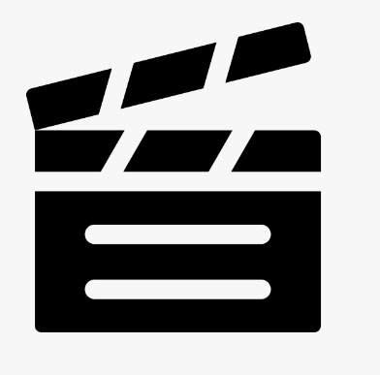
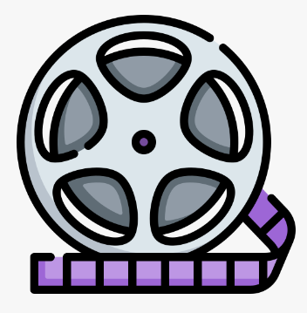
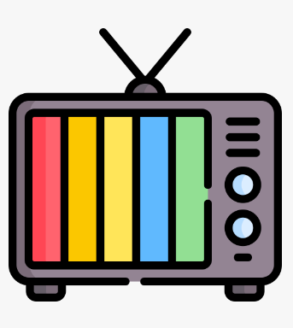
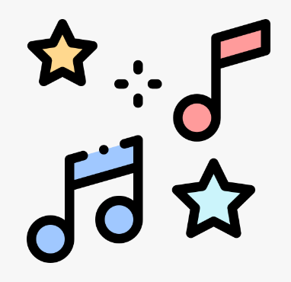

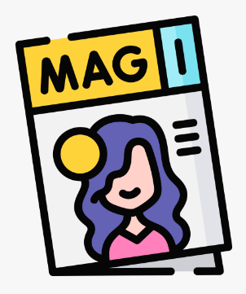
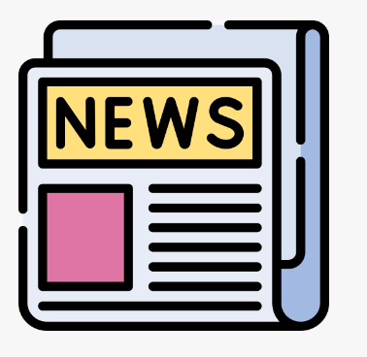


OCR GCSE Media Studies
Course Overview
Component 1
Television and Promoting Media
(1 Hour 45 Minutes)
70 Marks
9 Questions
Section A
Television:
‘Vigil’ and ‘The Avengers’
Section B
Promoting Media:
‘The Lego Movie’
Component 2
Music and News
(1 Hour 15 Minutes)
70 Marks
10 Questions
Section A
Music:
Study two music videos;
‘Mojo’ magazine
Section B:
Newspapers:
‘The Observer’
Component 3
Creating Media
30% of your grade
Completion of brief set by exam board. This will be completed in HT5 and HT6 of Year 10.

Slide 2
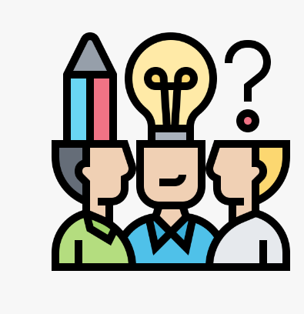

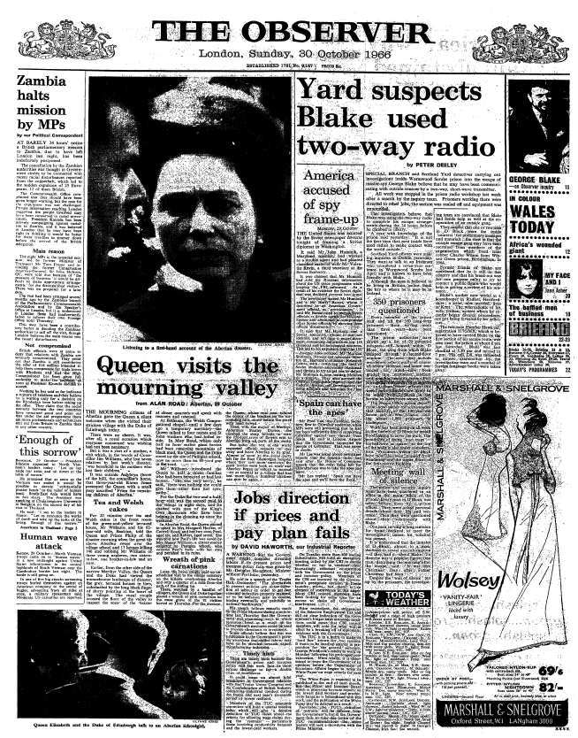
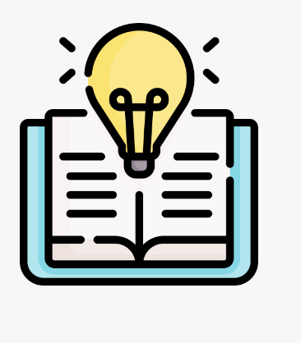
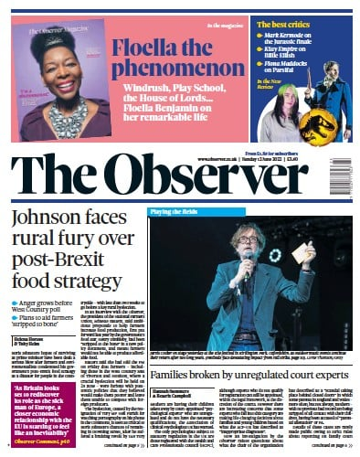
Learning Journey:
Year 11 Newspapers
Big Idea:
“I have opened newspapers and read incredible lies”
Introduction to newspapers
Overview of the ‘The Observer’
Historical context of ‘The Observer’
Set text study
Set text study
Formative assessment
WCF
Contemporary front cover
Contemporary front cover
How newspapers have changed
The Observer website
The Observer website
The Observer social media
The Observer social media
Exam question
Summative assessment
WCF
What are we learning?
This half term we will be studying the newspaper industry
We will study The Observer newspaper. An in depth study of: 2 contemporary front covers, 3 historical covers, online and social media.
We will explore industry, audience, media language and representation, context
We will practice exam questions ranging from one mark questions to essay questions.

Slide 3




Newspaper Conventions
Headline a short, attention-grabbing phrase printed in large type at the top of a news story.
Standfirst: An introductory paragraph in an article, printed in larger or bolder type or in capitals, which summarises the article.
Photo: Accompanies the story
Caption: A brief text accompanying a photograph to provide context
Uses and Gratification Theory (PIES)
Personal Identity: | Connotes a certain type of social attitude and political identity
Information and Education: | Newspapers offer a sense of knowing what is going on in the world.
Entertainment: | May take the form of humour e.g headlines, cartoons, opinion articles etc
Social Interaction: | Stories and opinions to readers that may form the basis of conversation. Responding to social media or website
Media Industries
Ownership: Guardian Media Group, owned by The Scott Trust
Scott Trust Values: liberal tradition – rights of the individual; democracy; internationalism; progress of society
Funding: circulation, paywalls, membership, print and online advertising; sponsored content, events, sales
Regulation: ISPO or IMPRESS but the Observer/Guardian has not signed up to either, preferring to be self regulating
Freedom of the Press: not censored or controlled by the state to provide democratic freedom of expression. Newspapers being regulated was after Leveson inquiry after phone hacking scandal
1960s Covers
Male/female representation unequal
Marriage/divorce not common (inter racial marriage on cover and divorce allowed)
Multiculturalism – lack of non BAME events or stories
Cold war/nuclear threat references in stories
Union strike actions common and lots of coverage of this with industrial reporter
Target Audience:
Demographic: ABC1 – people in good jobs who have more disposable income to buy nicer things go on holidays/trips
More male readers of print Equal male/female readers online and social media
Appeal: Interested in politics/international and national news/hard news Like the magazine inside – has sport/cooking/reviews/fashion
Observer Online
Positives: Free, updated all the time accessible on many platforms (convergence) 24/7in any part of the world Interactive
Negatives: Difficult to regulate Limited to the ‘look’ of that social media Need internet connection/data Fake news

